Slide 1


UNITED WAY OF BROWARD COUNTY
2
FINANCIAL SECURITY SPOTLIGHT:

Slide 2
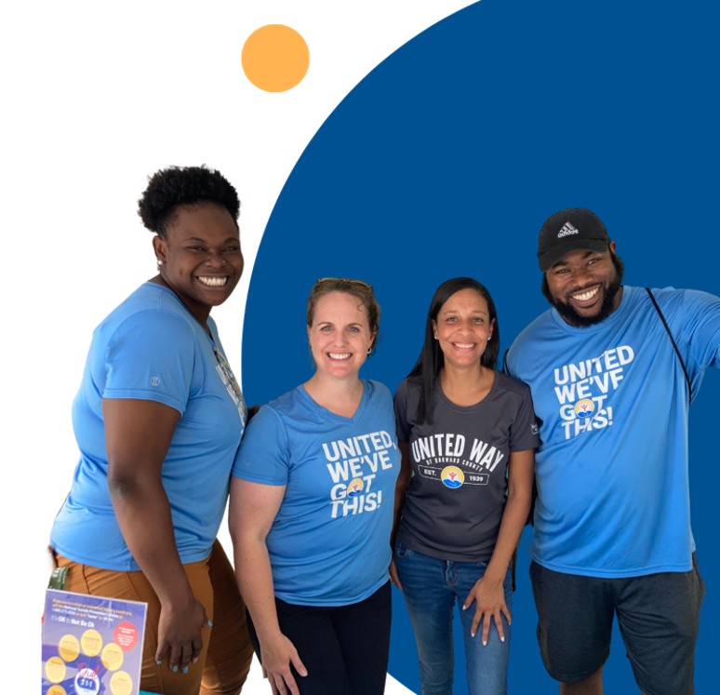
Our Reach
Thanks to your generous support, United Way of Broward County is able to create and fund more than 130 vital programs and services in our community, while also operating our own life-changing initiatives.
We find gaps in local services, innovate and implement effective and efficient solutions, and carefully monitor and measure each one to ensure it creates long-lasting, positive transformation.

Slide 3
The Affordable Housing Crisis in Broward County
A Deficit of Affordable Housing Units
Broward County needs an additional 120,843 affordable housing units to meet current demand
Availability
Only 25 affordable homes are available for every 100 families at 60% of the Area Median Income (AMI)
62% of Broward families are Rent Cost Burdened
Rent Cost Burdened is defined as paying more than
30% of total income
Increased by almost 40% from 2020 to 2023
Incomes increased by only 15%. Asset Limited, Income Constrained, and Employed (ALICE) population is most likely to be cost burdened
Current Average Rent in Broward County
1 BR: $1,900 2 BR: $2,500 3 BR: $3,100
Over 150,000 Affordable Housing Units Missing
Since 2012, more than 15,000 units below $250K
have been lost every year
Sources:
WLRN Public Media: Reports on the high rental market costs and the efforts by "housing navigators" to assist the homeless​ (WLRN)​.
United Way of Broward County: Provides insights into the Affordable Housing Dashboard and county-wide data on affordable housing needs​ (United Way of Broward County)​.
Florida Supportive Housing Coalition: Details on the Broward Partnership’s efforts and recent affordable housing projects like Seven on Seventh​ (FSHC)​.
Broward.US: Highlights the critical shortage of affordable housing units and the economic burden on residents​ (Broward.us)​.

Slide 4
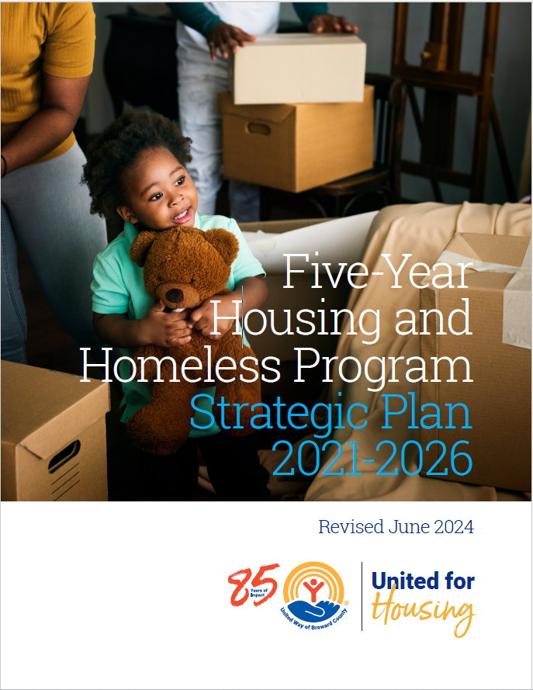
Vision:
United Way of Broward County envisions a system of care in which people at risk of homelessness receive necessary support to stay housed, people who become homeless are permanently housed with appropriate services, and long-term homelessness becomes a thing of the past.

Slide 5
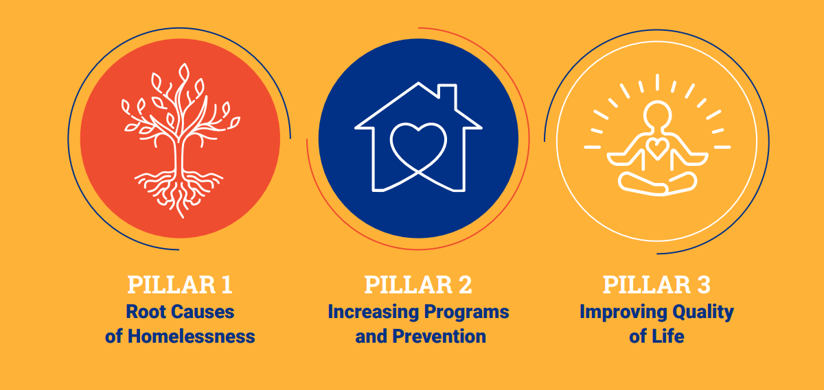
United for Housing

Slide 6
Policy Advocacy
System Improvements
Affordable Housing Preservation and Development
Community Engagement

Slide 7
Diversion and Prevention
Stable Housing Initiatives
Flexible Programs
Resource Development

Slide 8
Community Support
Enhanced Living Conditions
Inclusivity (Client Advisory Board)
Safety

Slide 9
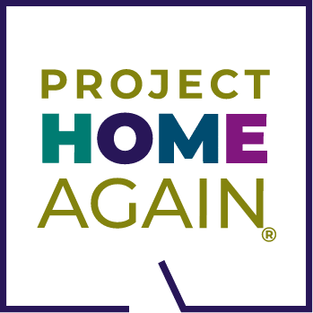

United for Housing Strategic Plan in Action
Program Funding:
Provide funding to more than 20 programs, including gap-funding for the development
of new units.
Housing Programs:
Provide Rapid Rehousing services and transitional Housing annually to more than
1,500 veterans.
Eviction Prevention: Provide eviction prevention and emergency assistance funding to individuals and veterans
at risk of homelessness.
Broward Business Council on Homelessness: Convening business leaders to identify, develop, and fund new housing strategies.

Slide 10
Engaging the Broward Business Council on Homelessness
Purpose: The Broward Business Council on Homelessness in collaboration with United Way of Broward County, aims to address critical community issues through business leadership and strategic partnerships.
Focus Areas: Economic development, workforce development and creation of accessible temporary and permanent housing for the chronically homeless
Key Role of United Way of Broward County: United Way serves as the backbone of the organization, fostering connections between the business leaders, nonprofits, and local government to drive meaningful change.

Slide 11
United Way of Broward County Housing and Homeless Initiatives
FY 2019 – 20:
City of Ft. Lauderdale provides $800,000 in funding for wraparound housing services.
FY 2021 – 22:
The Five – Year Housing and Homeless Strategic Plan 2021 – 2026 was developed and Implemented.
FY 2024 – 25:
The Five – Year Housing and Homeless Strategic Plan 2021 – 2026 was revised, streamlining the goals while addressing the evolution of environmental changes.
FY 2018-19: Broward Business Council created and implemented United WE End Homelessness
FY 2020 – 21 Needs Assessment for a Strategic Plan was conducted.
2018: Homeless Encampment
3 Goals Established:
1. Relocate individuals to safe and secure housing.
2. Develop partnerships and leverage resources.
3. Create programmatic and resource development infrastructure with key stakeholders and partners.
Use National Best Practice: Housing First Model, focusing on Rapid Rehousing and Homeless Prevention
FY 2019 – 20:
7 providers were funded to provide shelter, case management for housing and supportive services along with legal, benefits navigation, employment, and health services
FY 2020 – 21: Baseline data collected. Services established.
FY 2021 – 2024:
Providers funded. Services ongoing. Data collected.
Housing Dashboard launched.
FY 2024 – 25:
VP of Housing hired to address the evolving needs of the community and resources for the needs.

Slide 12
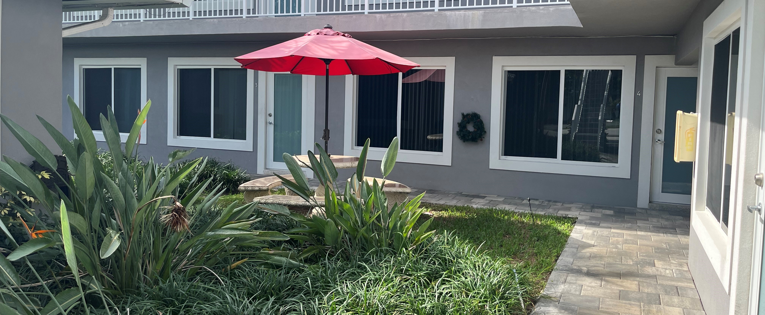
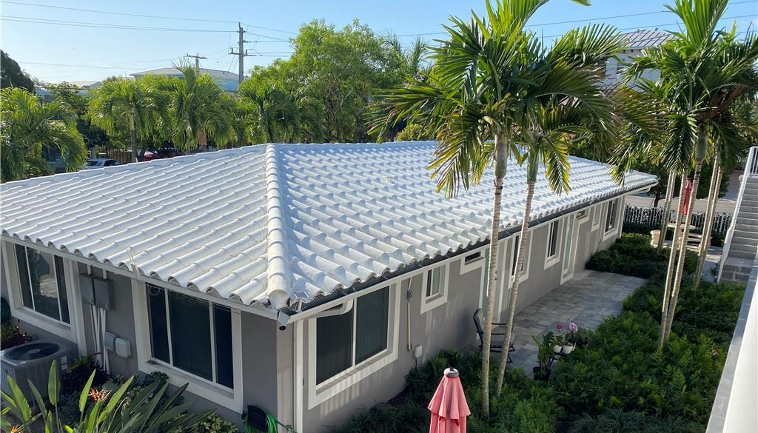
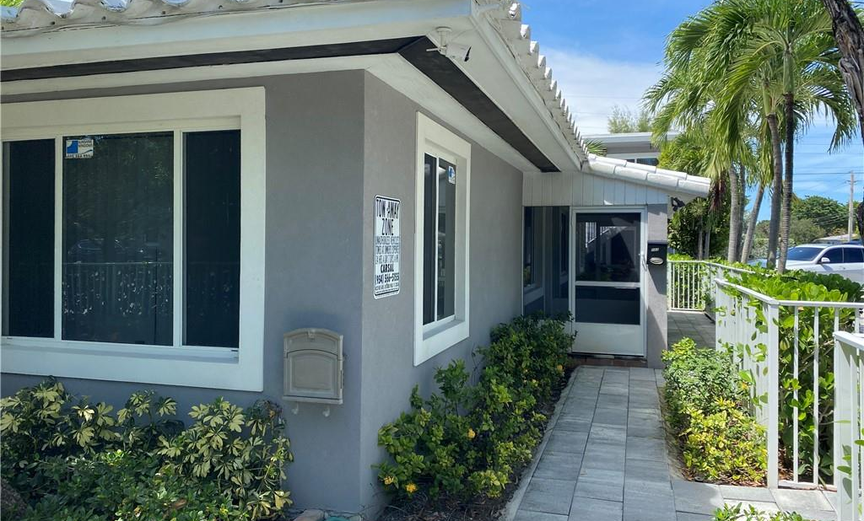
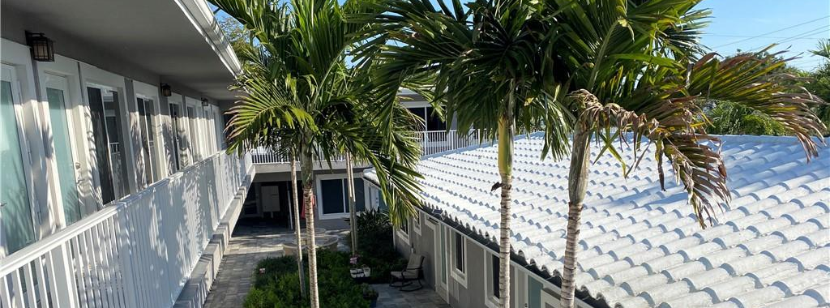

Slide 13



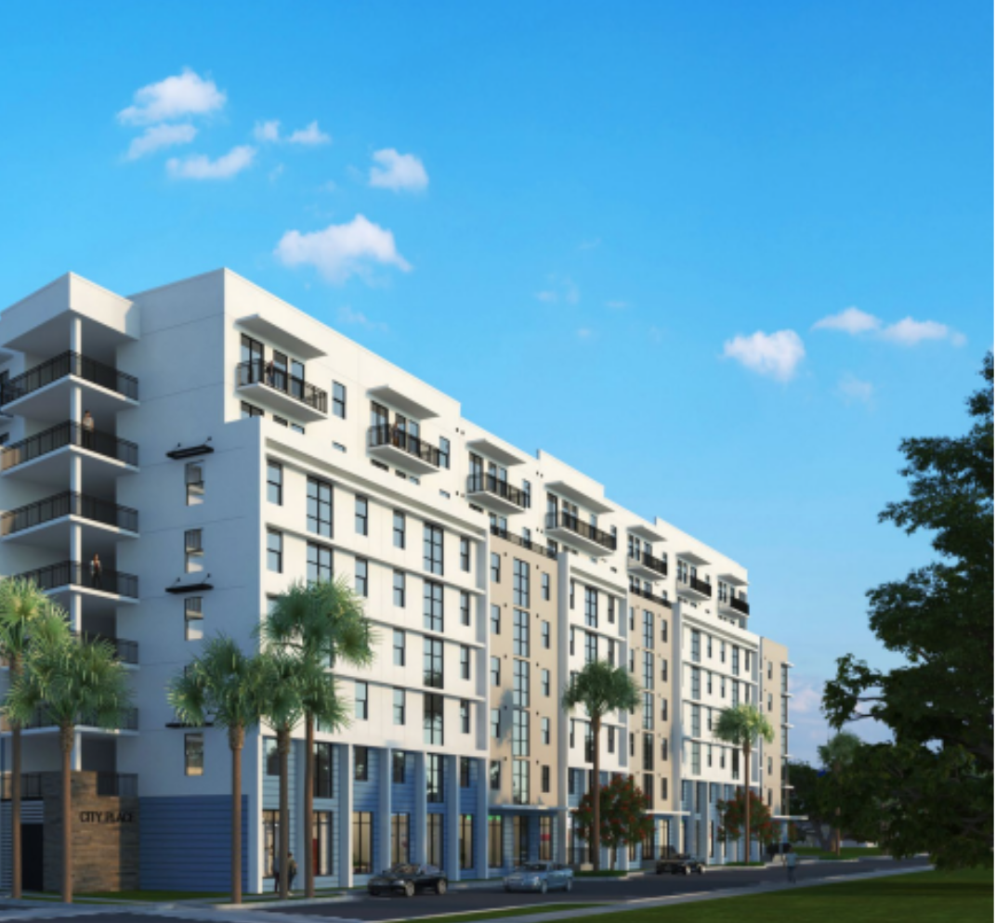
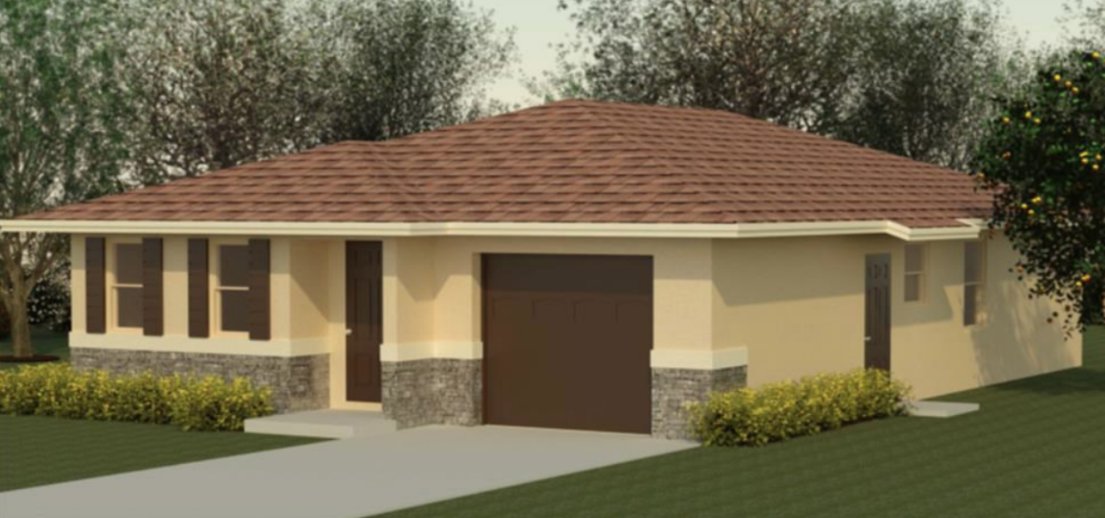
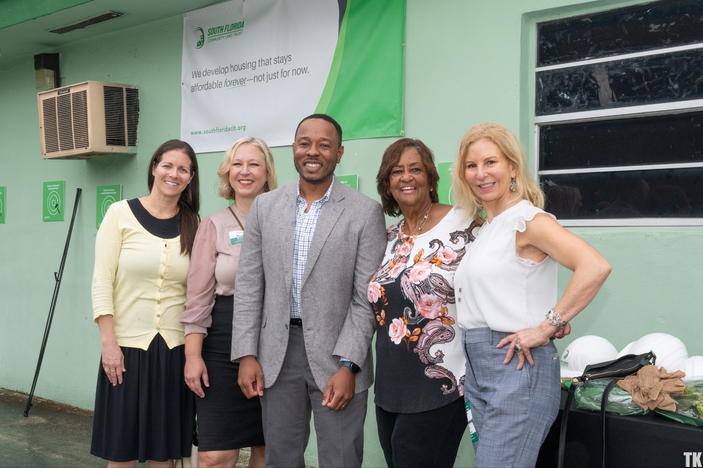
Partnerships
During 2020 to 2022, families suddenly became at risk of not being able to achieve the reality of homeownership. United for Housing filled the gap for 10 of the 12 homeowners with $250,000 as down payment assistance.
South Florida Community Land Trust (SFCLT) was able to keep rents low while providing major upgrades to the property for the health and safety of the residents. United for Housing has funded $140,000 to SFCLT.
City Place Apartments which will provide 99 new units and will remain “affordable” for a period of 50 years. United for Housing supported Landmark Development with a zero interest loan amount of $2MM. This helped close a $5MM gap they faced in the original pro forma.

Slide 14
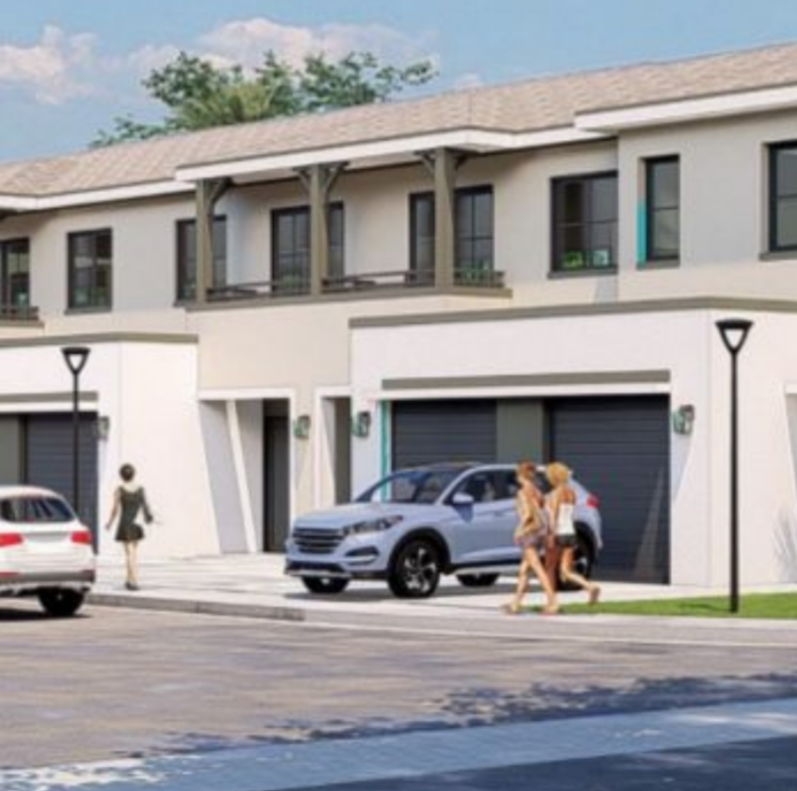
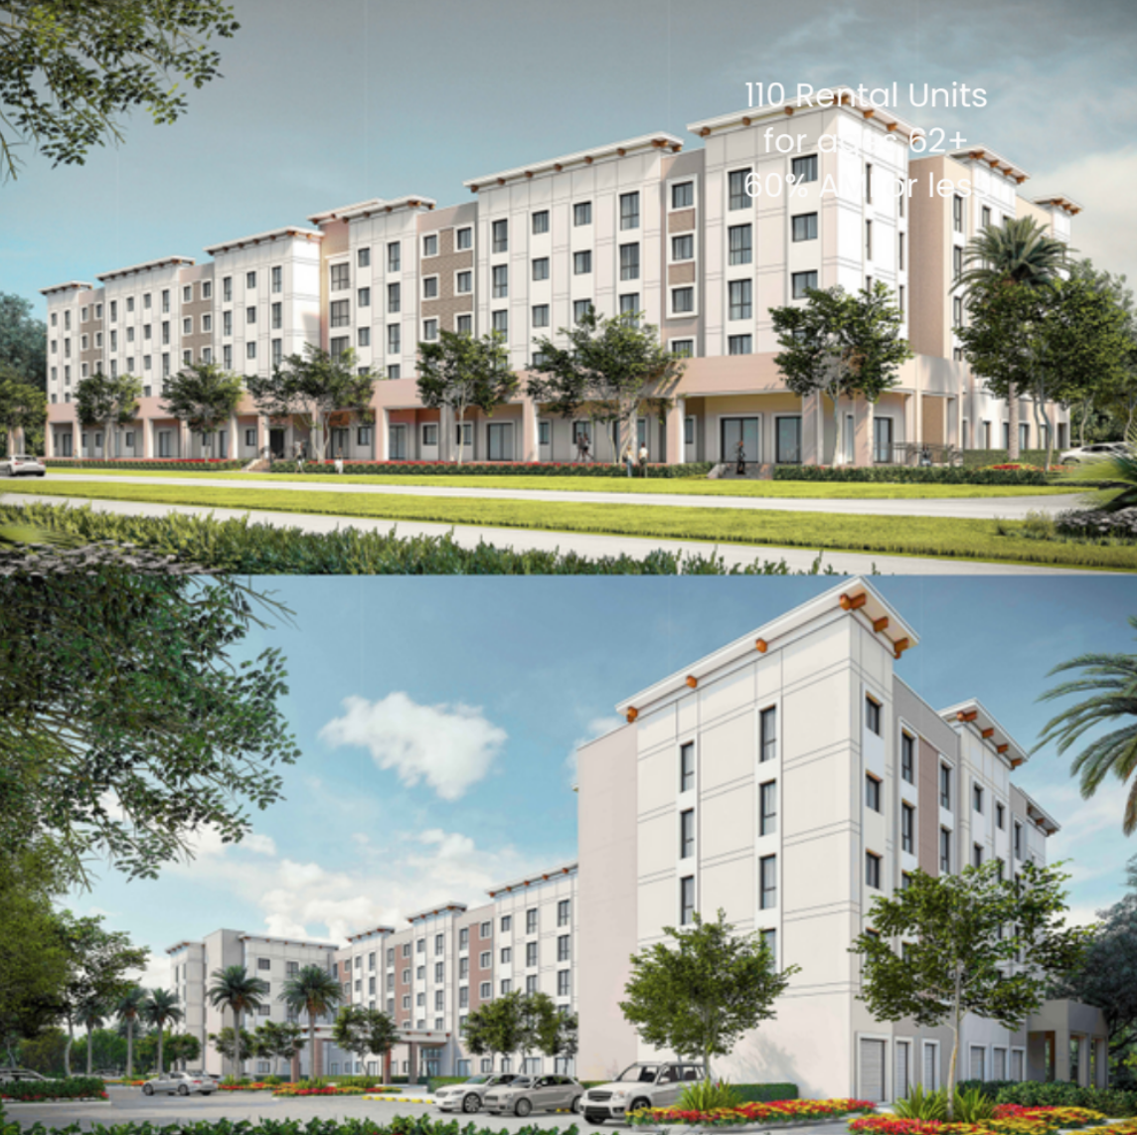
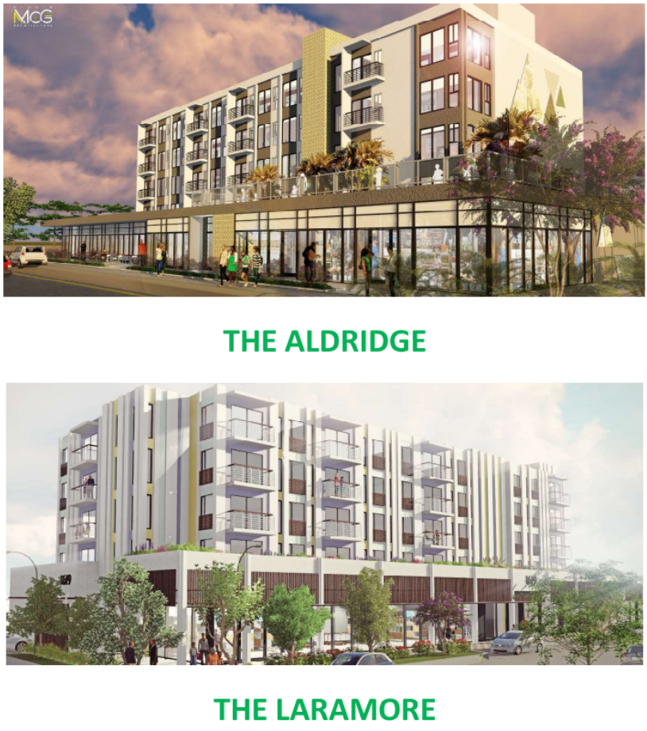

Partnerships
Parc View Townhomes
Pinnacle At La Cabana
United Way of Broward County is providing Financial Fitness courses to help families navigate the process of becoming first time homebuyers.
United for Housing has committed $500,000 to this project, of which $100K is for DPA for LI buyers.
The Pinnacle at La Cabana development has a focus on affordable housing for a specific population - those ages 62+. This development will create 110 new rental units and be adjacent to Miramar’s Adult Day Care Center.
United for Housing has committed $750,000 in funding.
The development of two modern mixed-use buildings – totalling 72 affordable rental units, ground floor retail space and secure parking for residents.
$1.4 investment

Slide 15

Housing United Strategic Plan In Action
The ache for home lives in all
of us, the safe place
where we can go as we are
and not be questioned.
-Maya Angelou

